Slide 1
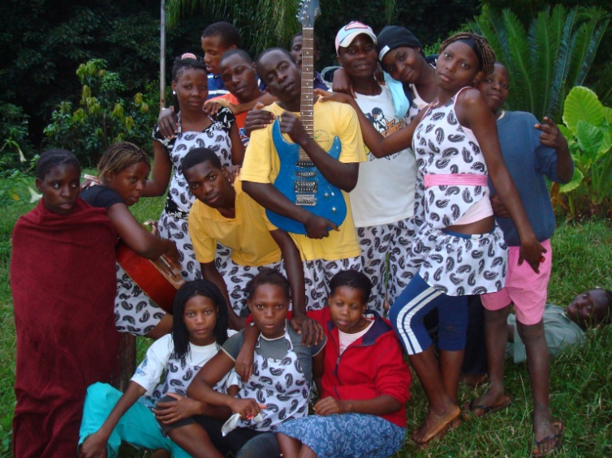
Building Community Awareness of Orphans and Vulnerable Children’s Rights through an Integrated Approach: Africare’s COPE Model
Presented By: Martina Forgwe
Authors: Santino Zhakata, Martina Forgwe, Dr. Kechi Achebe

Slide 2
Flora’s Story
Flora Tabarira is 43 years old
A widow and single mother of 6
Her oldest son, David Jose Paulo, had costly school fees and wanted to study at Chibata Primary School Teachers’ College; she could not afford to purchase uniforms and school materials for her younger children
She joined Muzongo CCC in 2008 and, as she described, “was born into a new family”
She participated in COPE sponsored IGA, including a chicken raising scheme
From chicken proceeds alone, Flora meets her household needs
She has sent her son to college and is sensitized to the importance of education for her children
Notes:
As caregivers die, the burden of care falls to extended families, communities, and community based organizations

Slide 3
Introduction & Contextual Framework
Sub-Saharan Africa is home to more than 11 million orphans
The impact of HIV and AIDS at the household level is particularly pronounced
Governments, local and international agencies have made child protection and child rights issues a significant priority of their HIV/AIDS programs, yet the challenges abound
Notes:
As caregivers die, the burden of care falls to extended families, communities, and community based organizations

Slide 4
The Mozambican Case
Mozambique has over 1.2 million OVC, roughly 16% of the total child population
The child marriage rate is among the world’s highest; 36.9% of married girls aged 15 to 19 have limited or no formal education
Child prostitution is increasing in major cities, rural areas and border towns along key transportation routes
Children are more exposed to risks such as child labor, conflict and detention, and early marriage

Slide 5
The Mozambican Case (2)
OVC’s rights are not taken seriously by adults around them
OVC dropout rates are significantly higher
The Mozambican government has prioritized community-based solutions to support OVC with support from the civil society and international partners.
The essential services in Mozambique include
access to education
nutrition and health care
income generating activities
psychosocial support

Slide 6
Africare’s COPE Model - Integrated Approach
The Community-Based Orphan Care, Protection and Empowerment (COPE) project model was launched in Zimbabwe in 2002, scaled up to Mozambique, Uganda, Rwanda and Tanzania
Africare works in 4 districts of Manica Province, which has an HIV and AIDS prevalence rate over 16%, among the highest in the country
Through five strategic cross-cutting strategic objectives, COPE strengthens the caregivers’ and communities’ (including community-based institutions such as churches, schools, and community organizations) capacities to care for OVC
It promotes shared responsibility of OVC and their caregivers by increasing community capacity to respond to their needs

Slide 7
Africare’s COPE Model in addressing OVC Child Protection Issues
Key Question: How can we provide a sustainable approach to protecting the rights of Children, especially OVCs?
The COPE model promotes child protection through linkages to existing community support structures that provide essential needs and services using:
-Community Care Committees
-OVC Committees
-Service Corps Volunteers
-Governmental Focal Point
Africare trains community-based volunteers, who form Community Caregiver Committees (CCCs) to provide children and communities with information, skills and knowledge to ensure the provision of child protection and care
Media (community radio, media outlets) is also used to sensitize communities and disseminate information on key issues relating to child rights and protection and empower the most vulnerable members of society

Slide 8
Africare’s COPE Model in addressing OVC Child Protection Issues (2)
Direct child involvement in radio presentations and production of community sensitization material by the children themselves, including songs, poems and drama skits, which are performed live through Community Media Centers (CMCs) as part of these sensitization and awareness campaigns
Partnerships built with the CMCs and educators in every province to launch a nation-wide advocacy campaign for child rights and protection
The advocacy approach promotes child participation in community development and facilitates the production of outreach material by the children themselves
The community is also capacitated to support OVCs to access essential skills and services, including education, health care, social welfare, vocational skills training and income generation opportunities

Slide 9
Results
Project achieved over 90% retention rates for the OVC enrolled under the COPE project
The COPE club model led to the development of a nationwide advocacy campaign for child rights and protection in all 11 provinces, involving 70 schools and 35 CMCs
COPE directly impacted 65,598 OCV and 17,752 caregivers
Overall community benefited, not only OVC
A noticeable decrease seen in stigma and discrimination of OVC, as the focus is not entirely on the orphans, but on meeting the needs of the entire community (i.e. quality education)
10,608 children vaccinated, ITNs to 30,771 children, and HBC to 960 OVC households

Slide 10
Results-2
17,751 households transformed from economic vulnerablility to independence through IGA
Birth registration campaigns increased access to civil services, from 38% and 39% of girls and boys in COPE areas to 74% and 75%
Life skills and psychosocial training provided for teachers to better serve their students
Enhanced school performance by OVC as a result of psycho-social support and emotional stability
Workforce development and vocational education for older OVC not able to attend formal school
Workshop training for CMCs to promote experience-exchange between and to improve child rights curriculum development with schools, government, and CMCs from every province.

Slide 11
Next Steps
Further develop advocacy and communication strategies among CMCs and teachers in child rights, identifying key issues affecting each region, and developing a strategic plan of action
Develop CMC and school curriculum including basic learning by club members about child rights (identifying common violations; laws of protection; identification of abused children; and referrals to health, counseling and legal and support centers)
Trained teachers will receive materials on child rights, child protection, and referral mechanisms to coordinate school and provincial level functions on child rights issues
They will also be trained on how to produce and disseminate community sensitization information through composing and recording music, theatre, poetry, and debates

Slide 12
Lessons Learned
Leveraging support from partners is crucial in ensuring that OVC receive a comprehensive package in all core program areas
Capacity building remains crucial for sustainability of project activities. Continued training of CCCs, SCV and members of the CF will greatly contribute to project sustainability
By focusing policy and service provision on the individual child, we miss the opportunity to draw on and strengthen the structures that are most effective in responding to their needs: the family and communities

Slide 13
Challenges
Many district and provincial government officials still do not collect or have access to data on OVC, which was a major gap for effective service delivery
It is necessary to conduct field level visits to monitor the quality of services provided
It is essential to link caregivers and CCCs to a ready market for IGA

Slide 14
Conclusion
The project’s success is dependent on having committed partnership with community-based institutions such as churches and schools, whose mission is to serve their populations, to enhance the potential to sustain such interventions

Slide 15
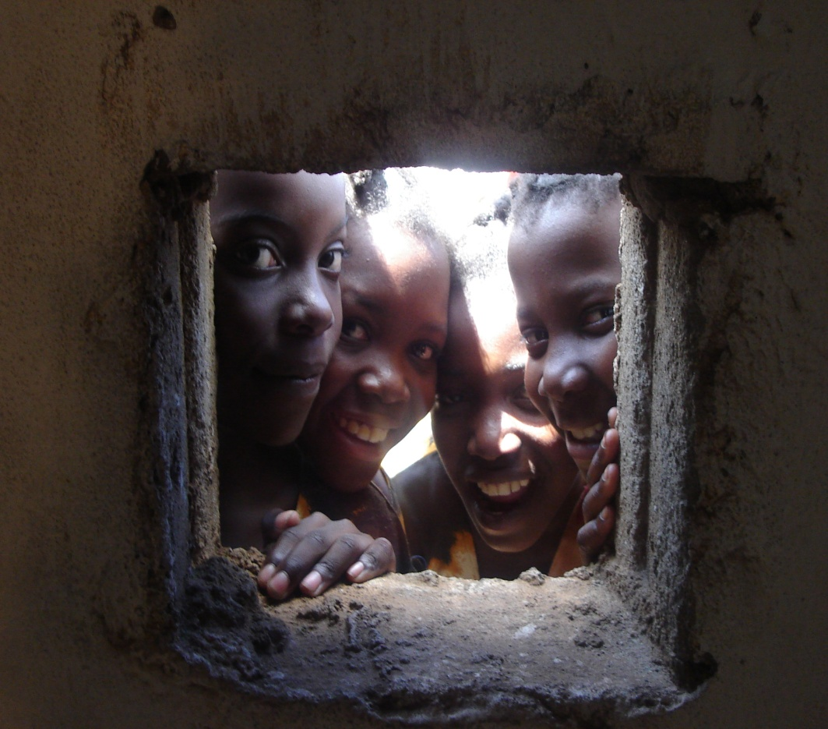
Thank You!

